Slide 1
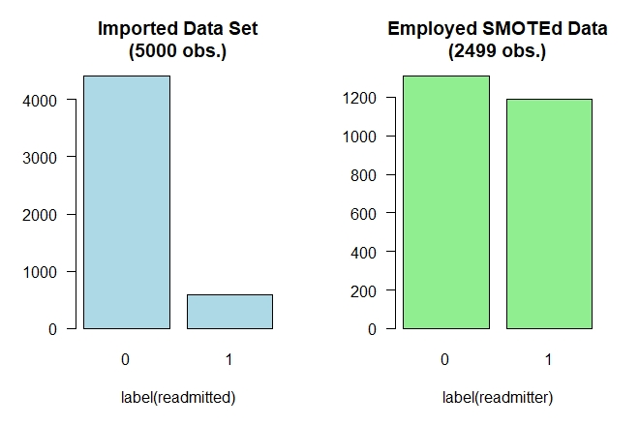
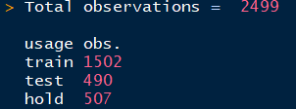
Notes:
660x440
Total observations = 2499
usage obs.
train 1502
test 490
hold 507

Slide 2
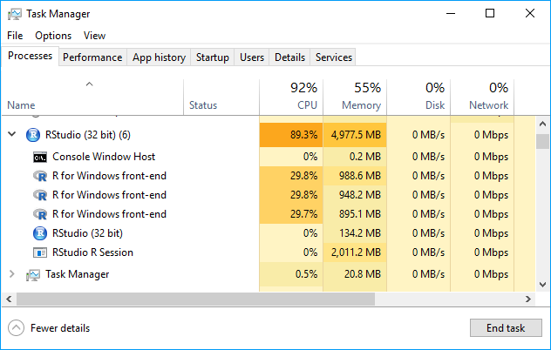

Slide 3
Training Statistics (sec.) of Ensemble Learning
method | $everything |  |  | $train (1,502 obs.) |  |  | $predict (490 obs.)
 | user | system | elapsed | user | system | elapsed | user | system | elapsed
nnls | 854.3 | 150.68 | 1004.54 | 765.47 | 136.51 | 902.58 | 88.82 | 14.17 | 101.95
auc | 920.63 | 144.14 | 1070.83 | 831.11 | 131.03 | 969.97 | 89.41 | 13.08 | 100.72
nnloglik | 865.45 | 144.04 | 1008.44 | 777.87 | 131.42 | 910.27 | 87.58 | 12.62 | 98.17

Slide 4
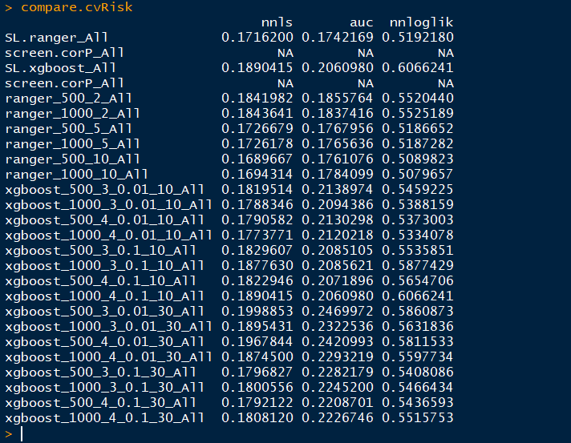

Slide 5
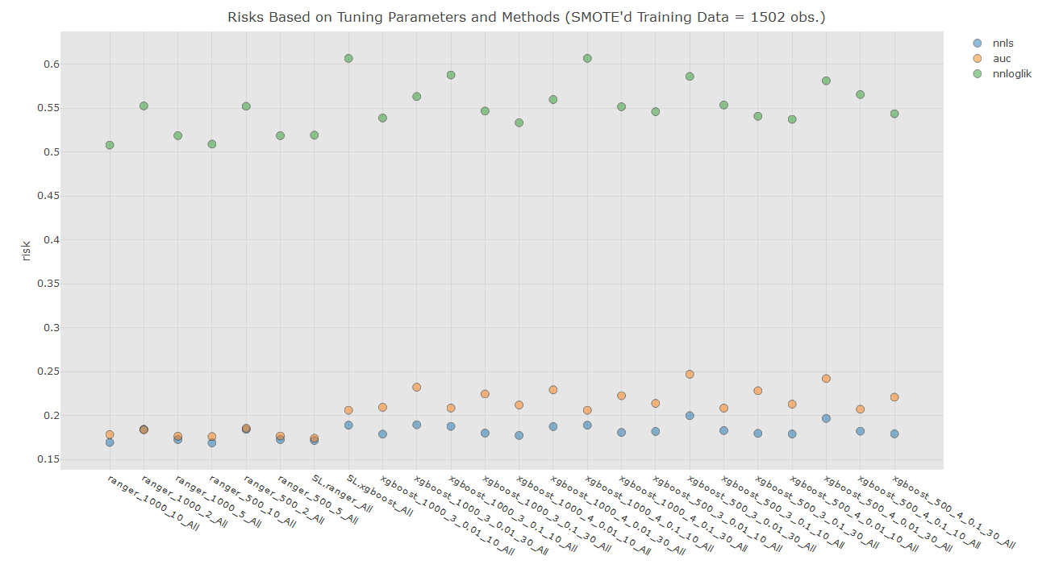

Slide 6
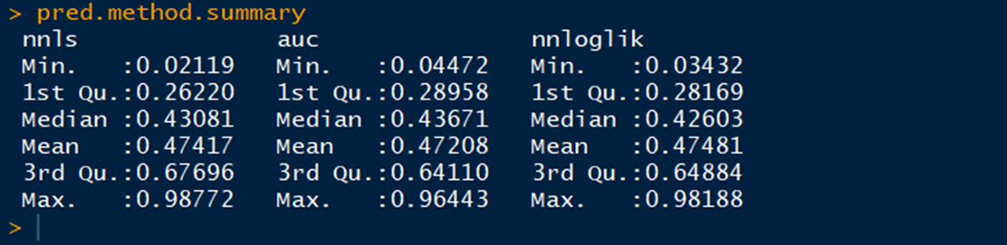

Slide 7
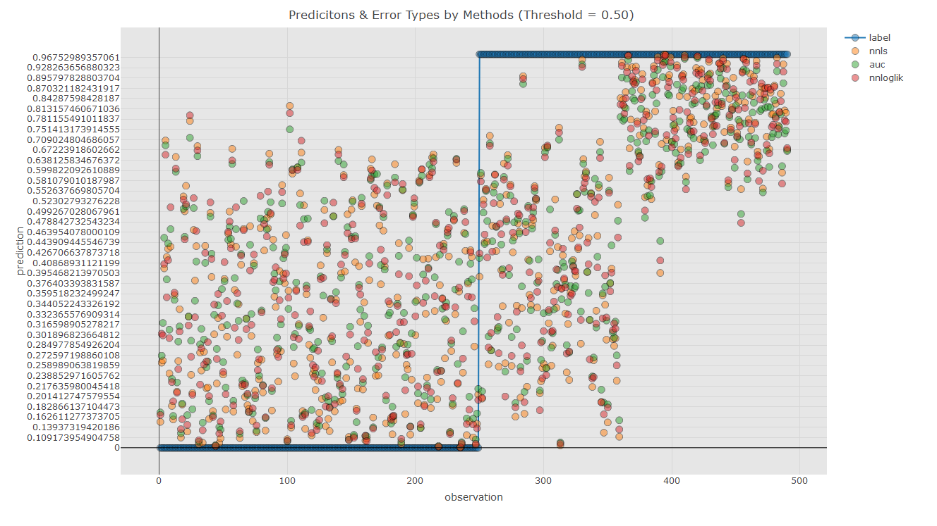

Slide 8
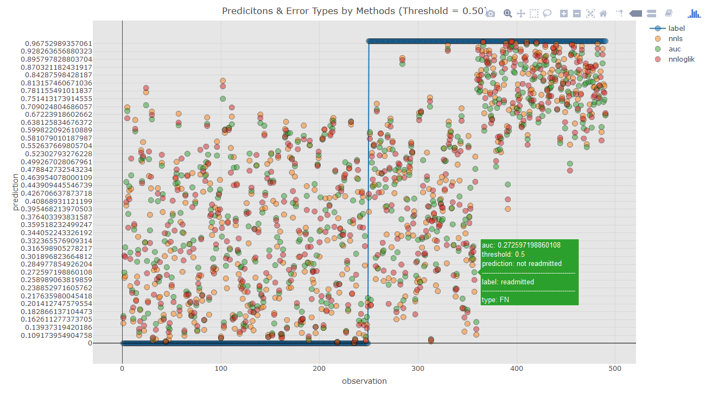

Slide 9
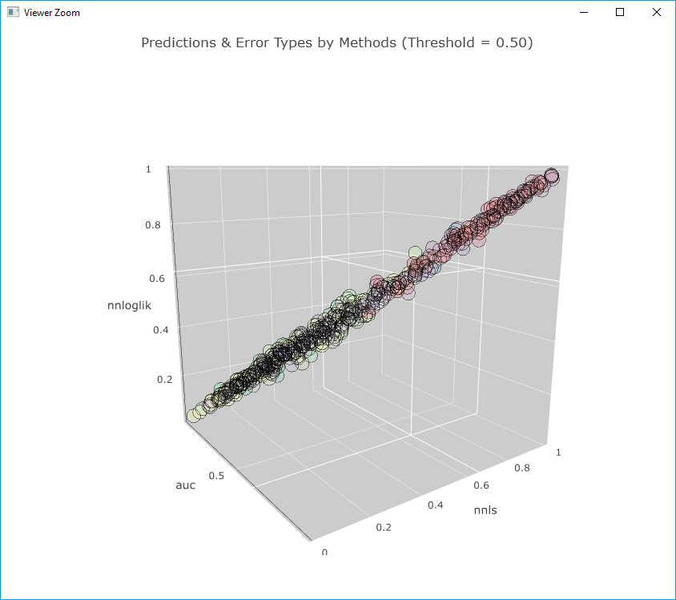
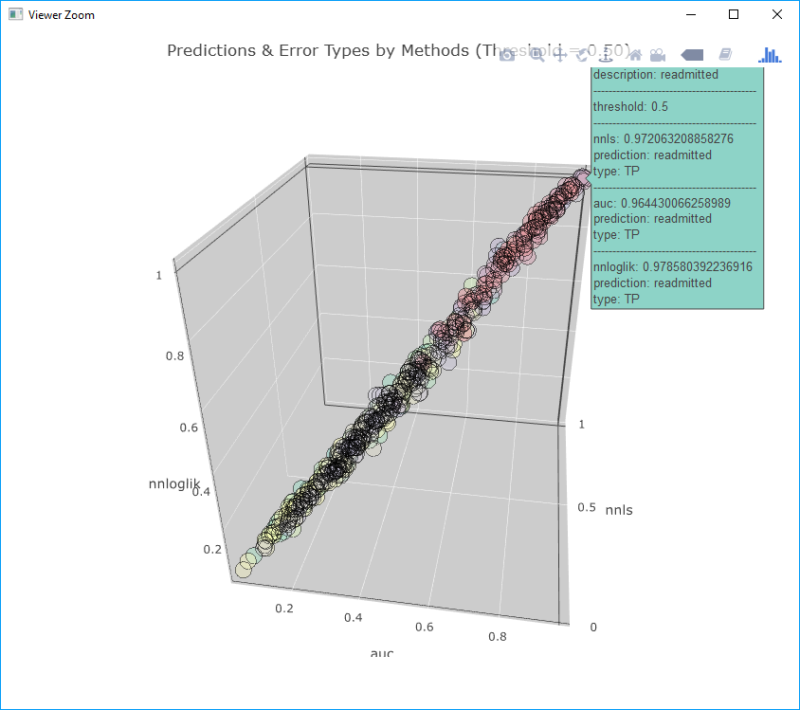
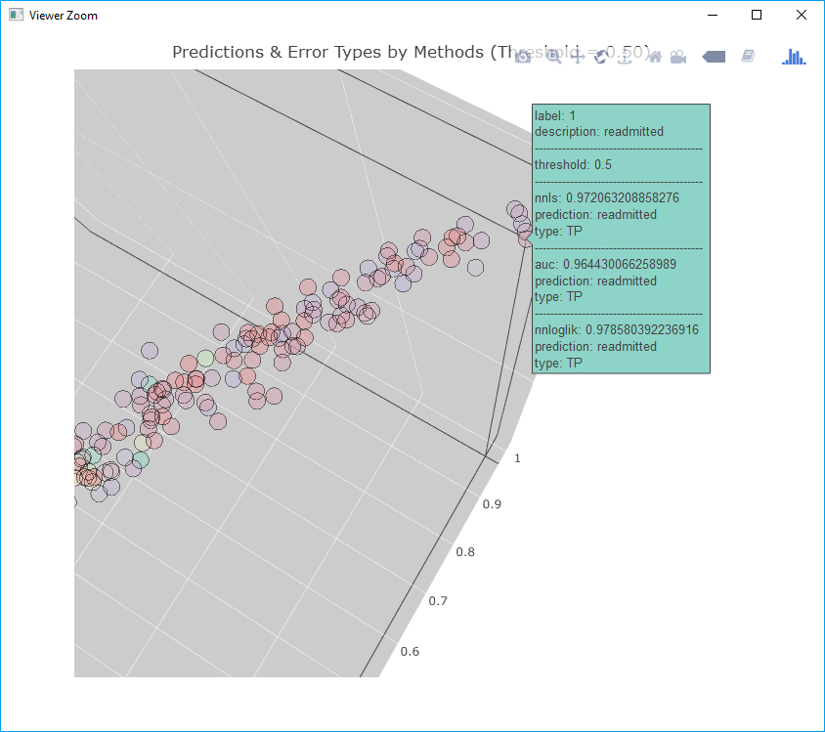

Slide 10
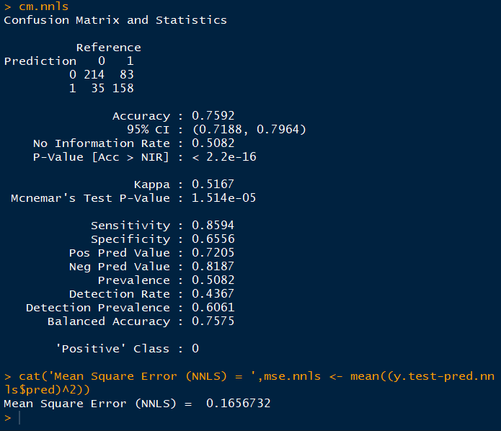
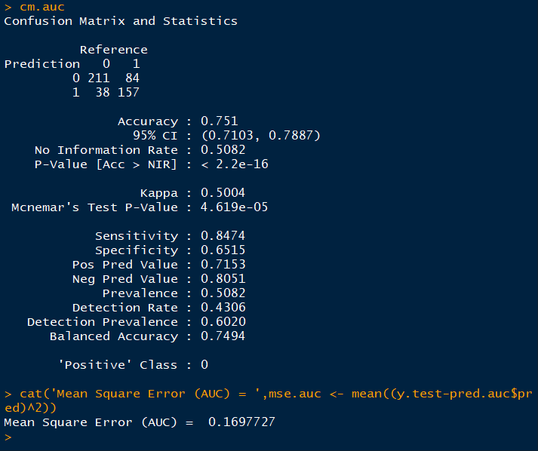
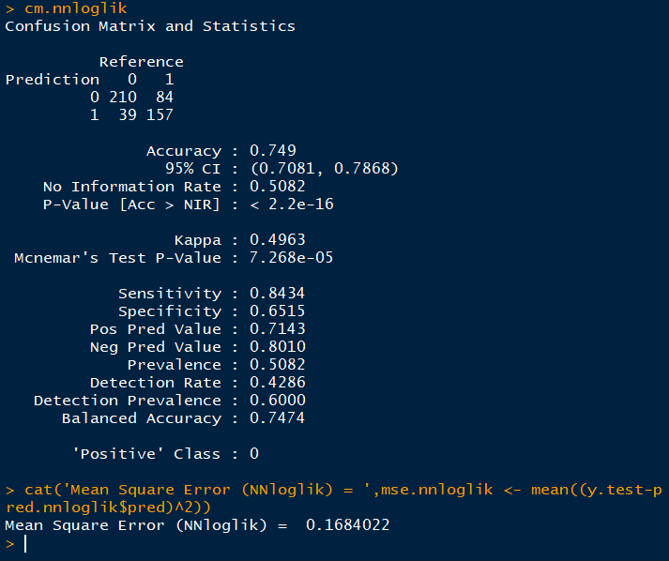

Slide 11
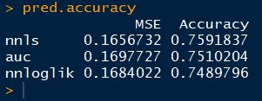

Slide 12
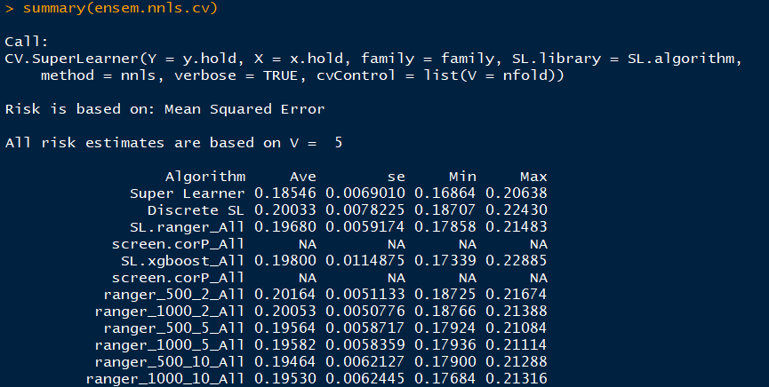
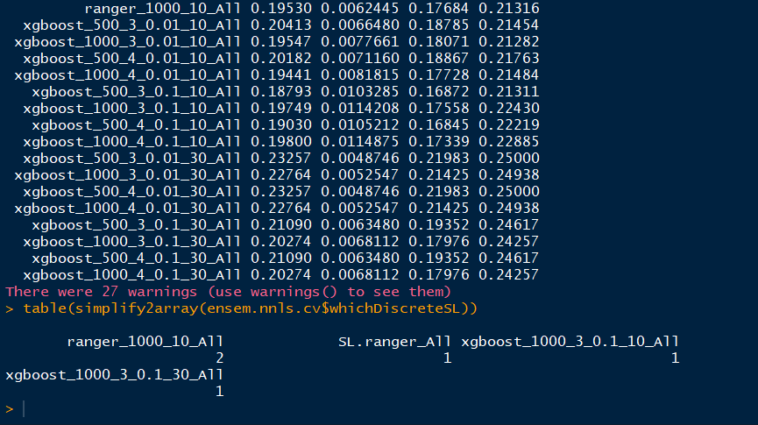

Slide 13
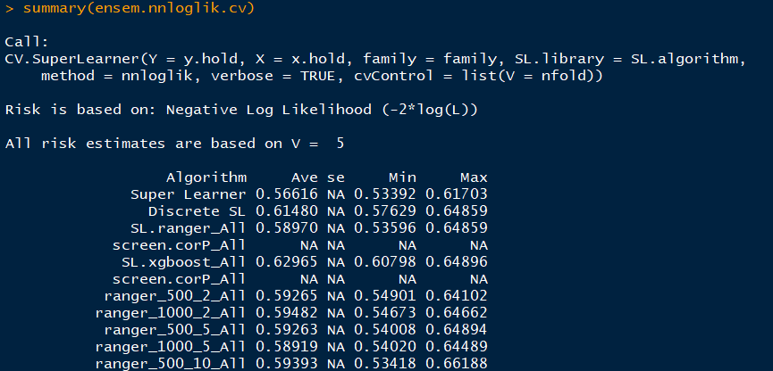
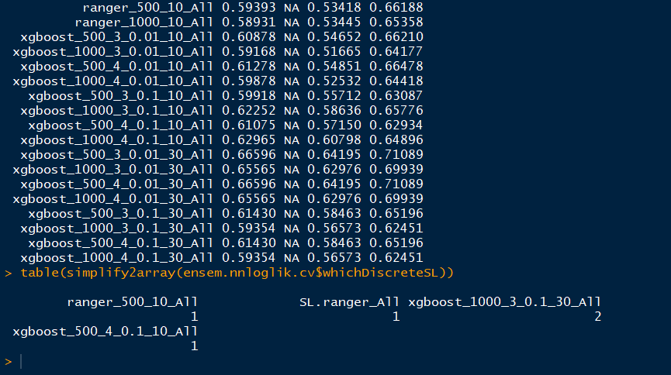

Slide 14
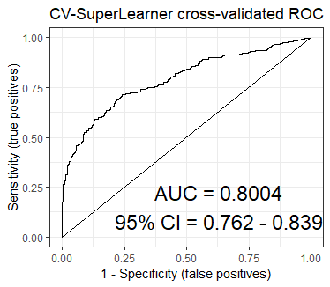
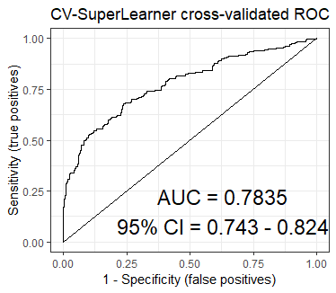
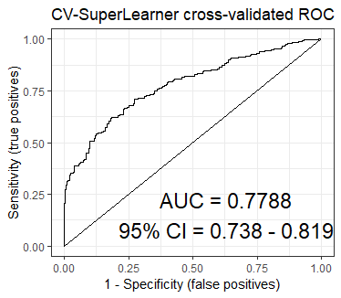
nnls
auc
nnloglik

Slide 15
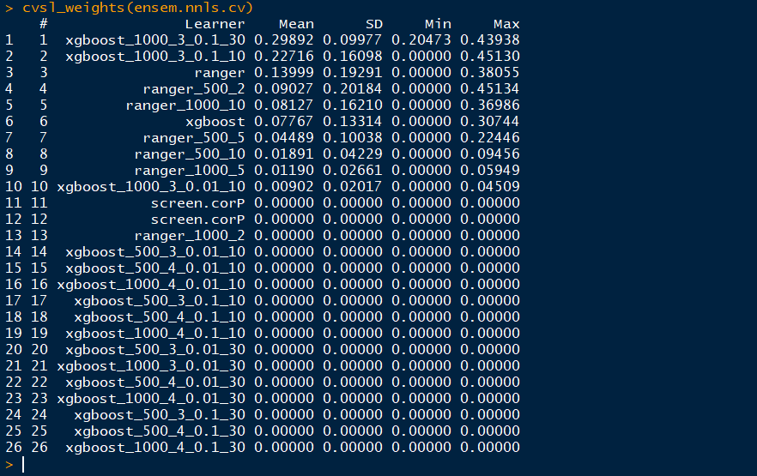
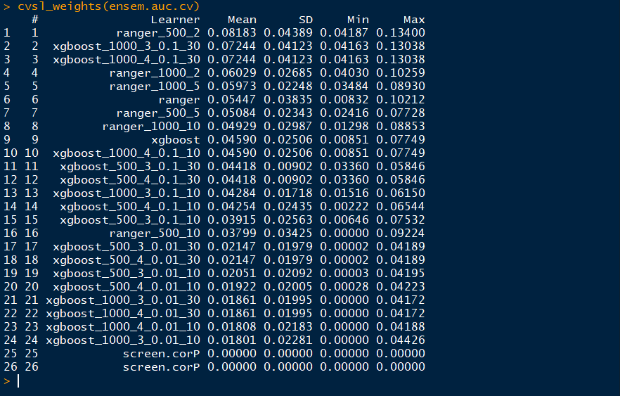
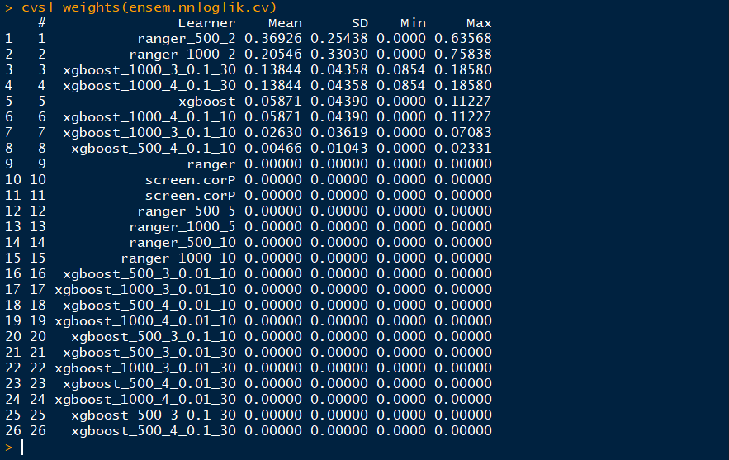

Slide 16
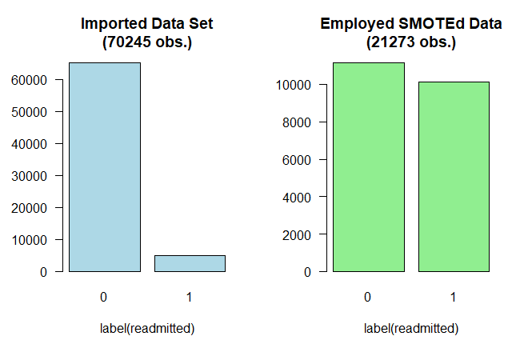
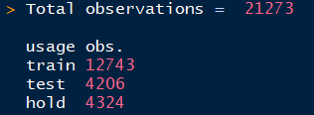
Notes:
Total observations = 21273
usage obs.
train 12743
test 4206
hold 4324

Slide 17
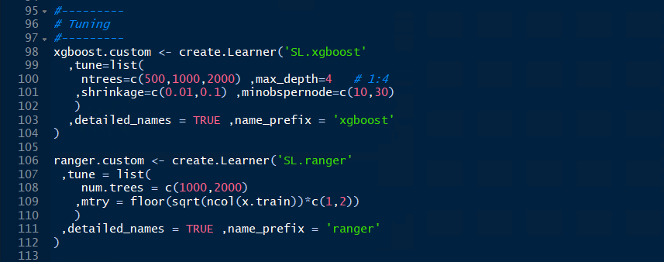
Notes:
#---------
# Tuning
#---------
xgboost.custom <- create.Learner('SL.xgboost'
,tune=list(
ntrees=c(500,1000,2000) ,max_depth=4 # 1:4
,shrinkage=c(0.01,0.1) ,minobspernode=c(10,30)
)
,detailed_names = TRUE ,name_prefix = 'xgboost'
)
ranger.custom <- create.Learner('SL.ranger'
,tune = list(
num.trees = c(1000,2000)
,mtry = floor(sqrt(ncol(x.train))*c(1,2))
)
,detailed_names = TRUE ,name_prefix = 'ranger'
)

Slide 18
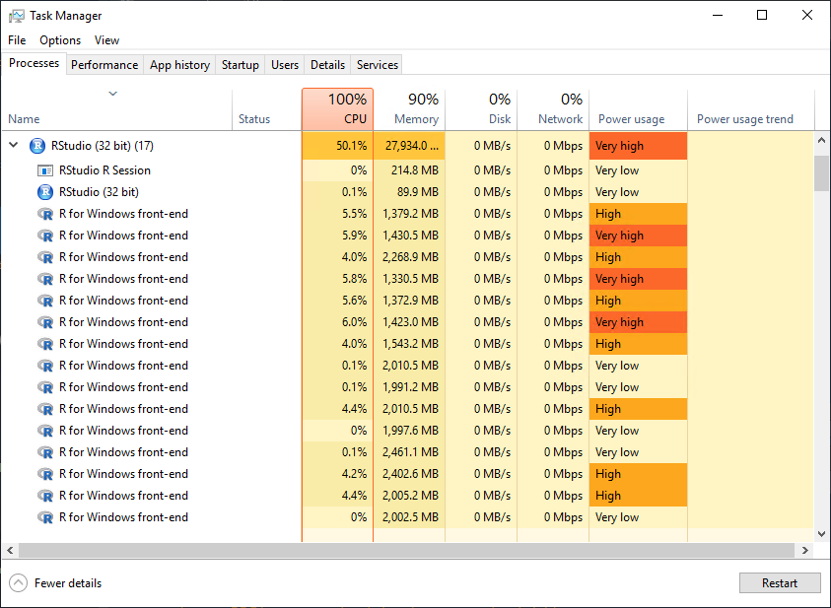

Slide 19
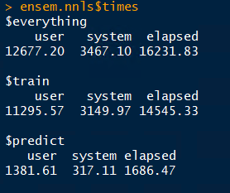
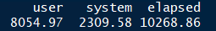
Notes:
CV RUN
user system elapsed
6.77 1.89 2343.43

Slide 20
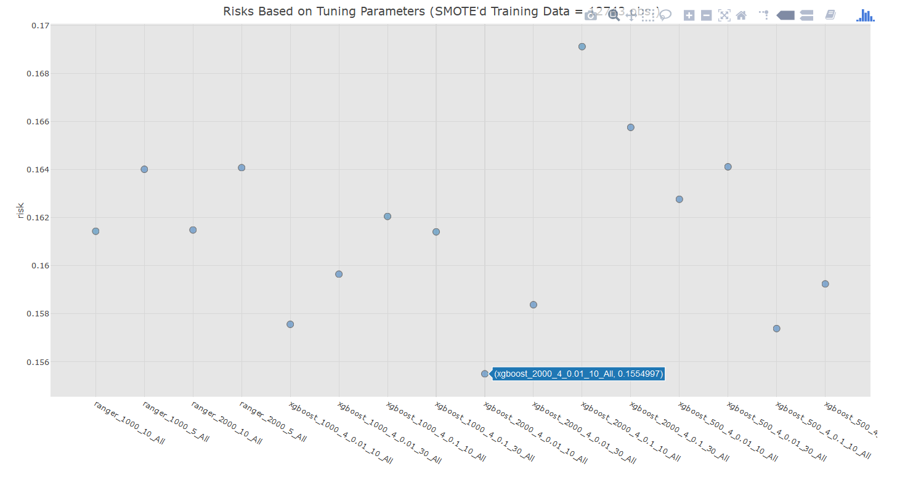
Notes:
12743

Slide 21
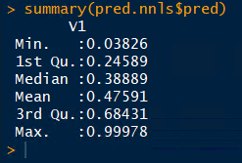

Slide 22
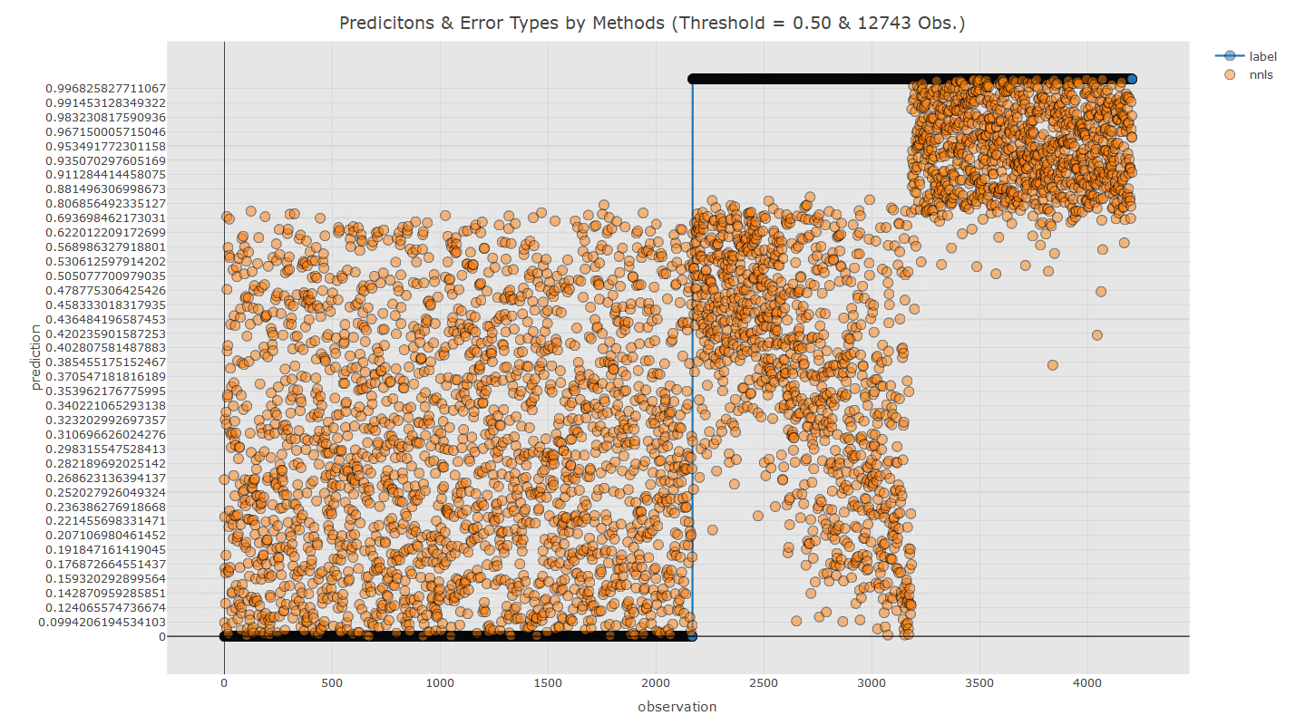

Slide 23
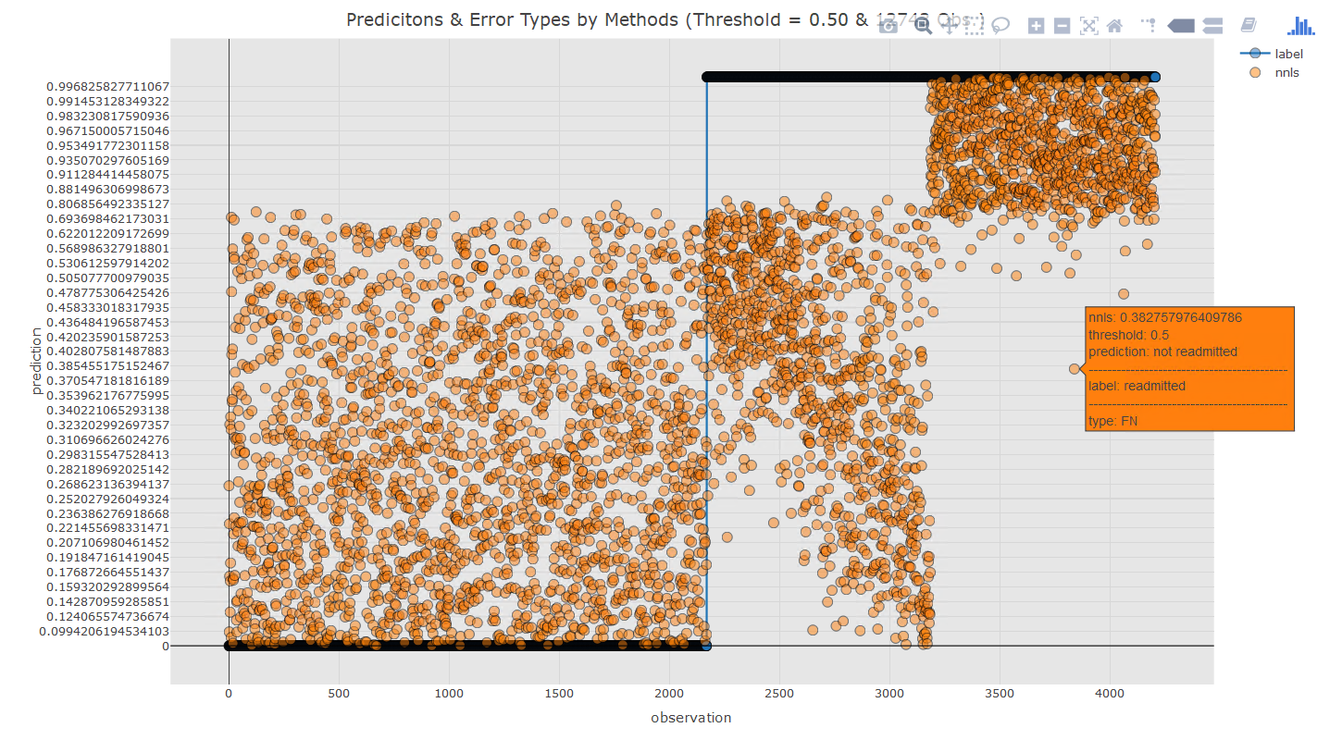

Slide 24
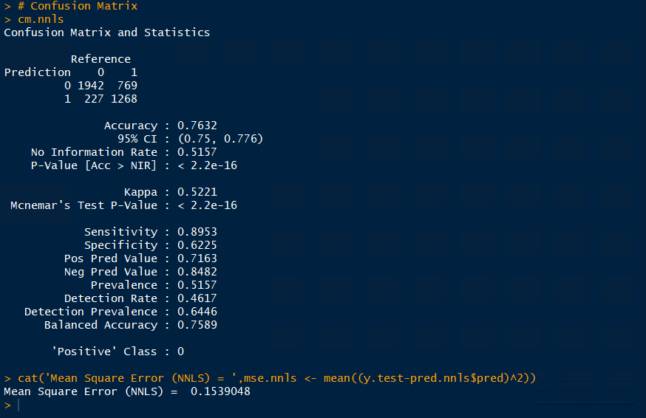

Slide 25
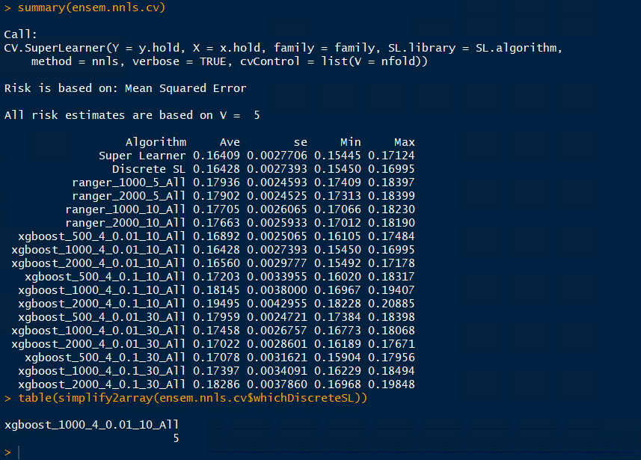

Slide 26
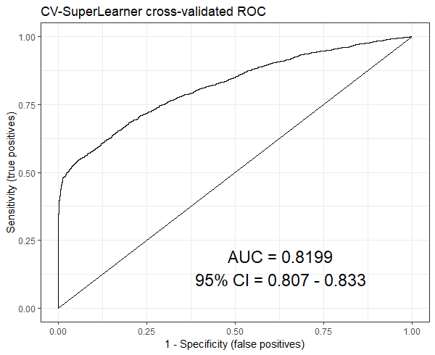

Slide 27
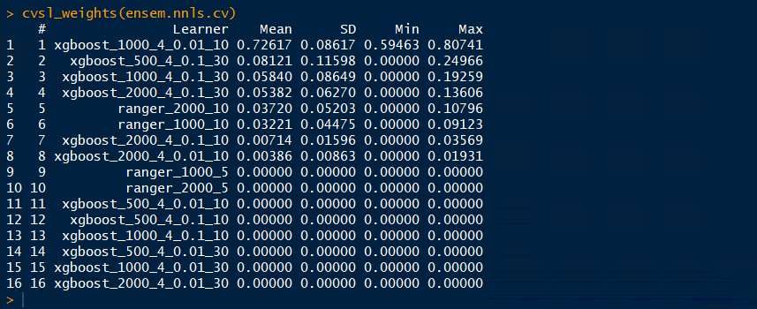

Slide 28
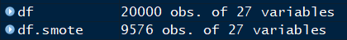
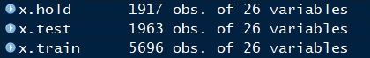
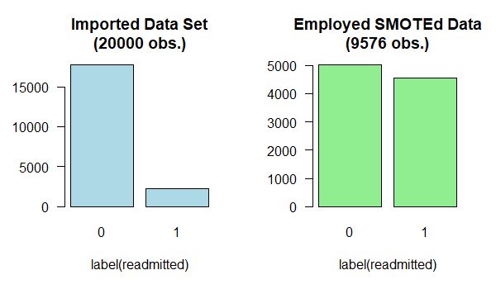
Notes:
table(df$readmitted)
0 1
2280

Slide 29
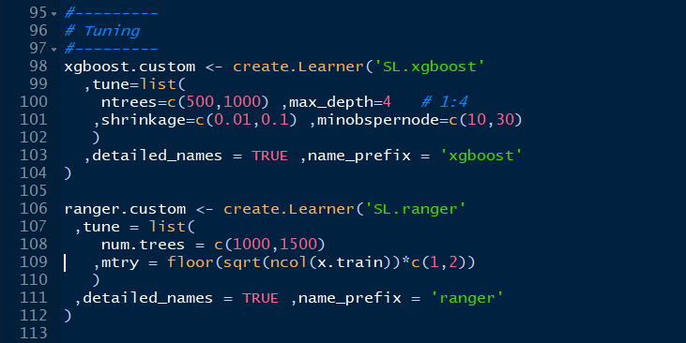
Notes:
#---------
# Tuning
#---------
xgboost.custom <- create.Learner('SL.xgboost'
,tune=list(
ntrees=c(500,1000) ,max_depth=4 # 1:4
,shrinkage=c(0.01,0.1) ,minobspernode=c(10,30)
)
,detailed_names = TRUE ,name_prefix = 'xgboost'
)
ranger.custom <- create.Learner('SL.ranger'
,tune = list(
num.trees = c(1000,1500)
,mtry = floor(sqrt(ncol(x.train))*c(1,2))
)
,detailed_names = TRUE ,name_prefix = 'ranger'
)

Slide 30
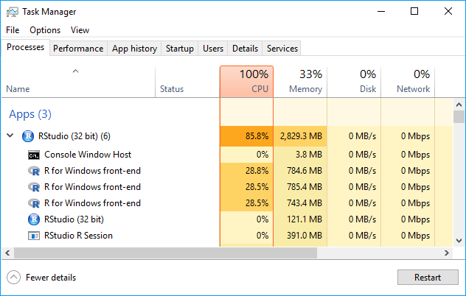

Slide 31
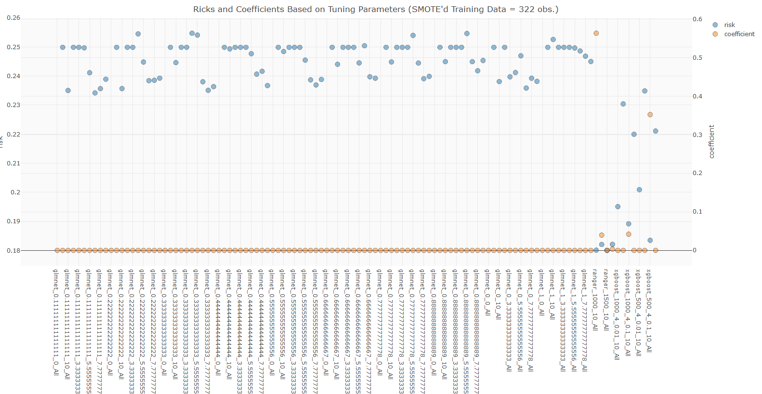
In this test, SuperLearner evaluated all glmnet functions as with higher risks, in blue, than those of ranger and xgboost, and also assigned zeros to the associated coefficients, in orange.

Slide 32
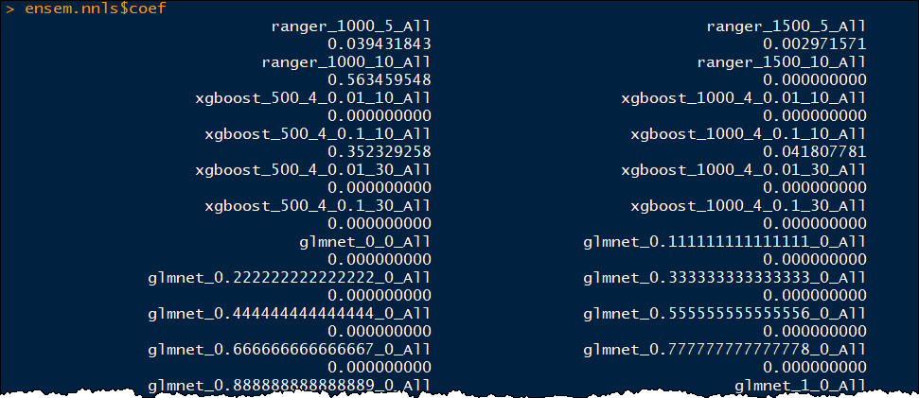
In this test, SuperLearner assigned each glmnet learners with a zero for the coefficient which essentially removed the algorithm from the ensemble for making predictions.

Slide 33
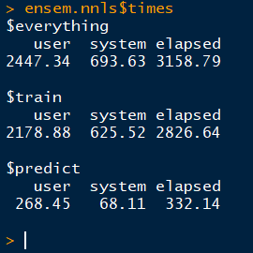
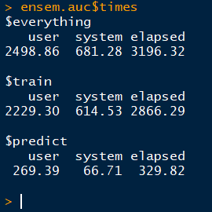
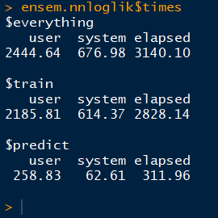
Notes:
Cross validation for 9576, each method about 20-30 minutes elapsed time
NNLS
user system elapsed
0.33 0.50 1574.17
AUC
user system elapsed
3.53 1.03 1221.45
Nnloglik
user system elapsed
0.34 0.17 1172.98

Slide 34
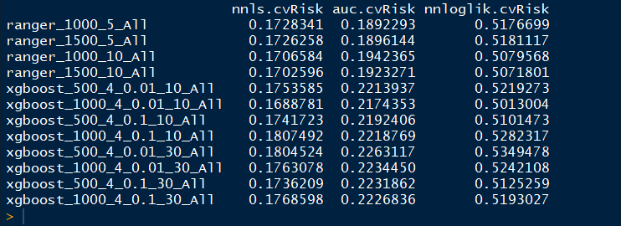


Slide 35


Slide 36

Notes:
1300x740

Slide 37


Slide 38


Slide 39


Slide 40


Slide 41


Slide 42


Slide 43


Slide 44


Slide 45




Slide 46


Slide 47


Slide 48


Slide 49


Slide 50



nnls
auc
nnloglik

Slide 51




Slide 52


Slide 53


Slide 54



Slide 55


Slide 56


Slide 57



Slide 58


Slide 59




Slide 60




Slide 61


Slide 62



Slide 63


Slide 64


Slide 65





Slide 66




Slide 67




Slide 68



nnls
auc
nnloglik
Notes:
cvsl_auc(ensem.nnls.cv)
$cvAUC [1] 0.7567559
$se [1] 0.01509683
$ci [1] 0.7271667 0.7863451
$confidence [1] 0.95
cvsl_auc(ensem.auc.cv)
$cvAUC [1] 0.7708752
$se [1] 0.01452117
$ci [1] 0.7424143 0.7993362
$confidence [1] 0.95
cvsl_auc(ensem.nnloglik.cv)
$cvAUC [1] 0.7675703
$se [1] 0.01489233
$ci [1] 0.7383819 0.7967588
$confidence [1] 0.95

